Slide 1
ConnectivityGovernance API
Infosys Ltd.
Contacts:
Pawan.7.kumar@bt.com, abhisek.das04@infosys.com, bishnu_panda@infosys.com

Slide 2
Contents
Background
Connectivity Governance Solution
ConnectivityGovernance API
User story
Connectivity Governance API Deliverables Plan

Slide 3
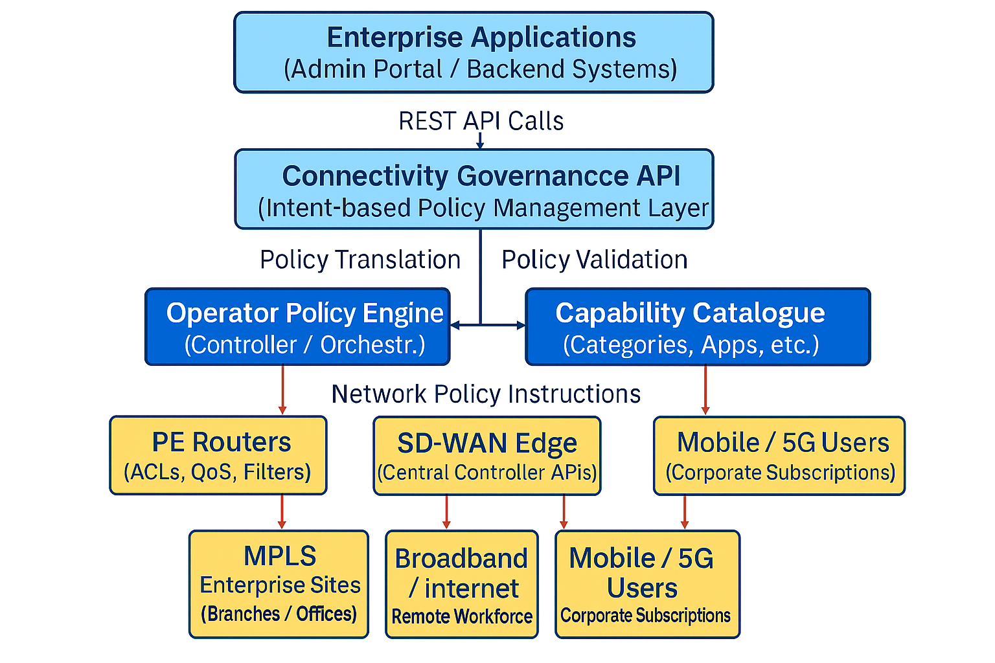
Background- what drives Connectivity Governance API
API benefit
Block risky applications for all roaming devices
Apply temporary emergency bandwidth throttling
Reduces risk without invading employee privacy and across devices.
Enterprise-grade governance without agents and compliments CASB solutions.
A multi-tiered policy enforcement can be enforced on the back of this solution.
New business scenarios driven：
A network‑level policy enforcement API that enables telcos to provide enterprise customers with centralized control over application access, bandwidth optimization, productivity protection, and compliance enforcement across MPLS, SD‑WAN, and mobile networks—without requiring any device‑level software or agents. Unlike traditional endpoint‑based tools such as MDMs or content filters, which add operational overhead and are easily bypassed, this API enforces policies directly at the network gateway layer (PE routers, SD‑WAN edges, or the telco core), ensuring consistent, tamper‑proof, and cross‑device enforcement. This capability can also be offered as a differentiated, revenue‑generating add‑on bundled with enterprise connectivity products.This API is proposed for enterprise customers and use cases exist across Health Care, Legal, Media/Entertainment domain.

Slide 4
API Scope (Connectivity Governance)
In-Scope
Exposes portable, intent‑based governance for enterprise connectivity: define policies (allow/deny, QoS priority, rate‑limit, time windows) against a connectivity scope (enterprise, site, segment, subscription group, 5G slice).
Provides capability discovery (supported categories/actions/limits) to ensure multi‑operator interoperability.
Standardizes resource model, error format, and security per CAMARA Commonalities.
Out of Scope
No endpoint/agent management or device telemetry, enforcement is network‑side only.
No commitment to specific vendor DPI/SD‑WAN features, maps intents to operator backend abstractly.
Not a replacement for CASB/MDM feature parity, designed to complement network controls.

Slide 5
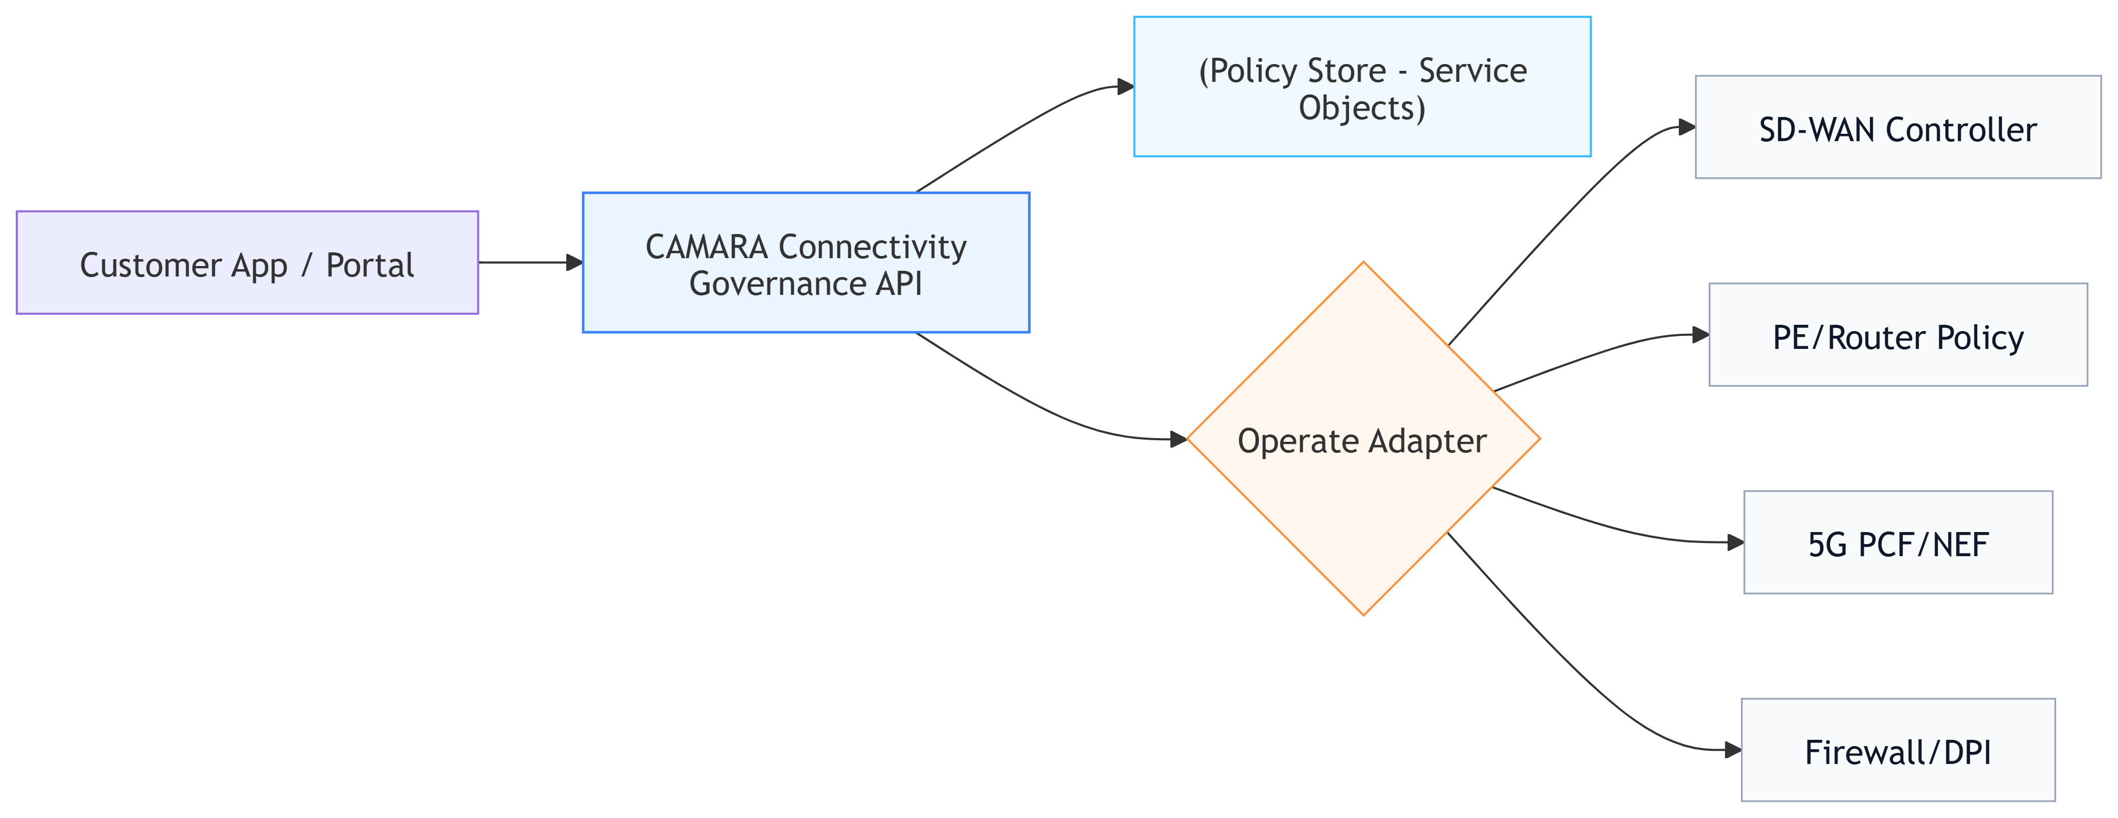
Connectivity Governance API

Slide 6
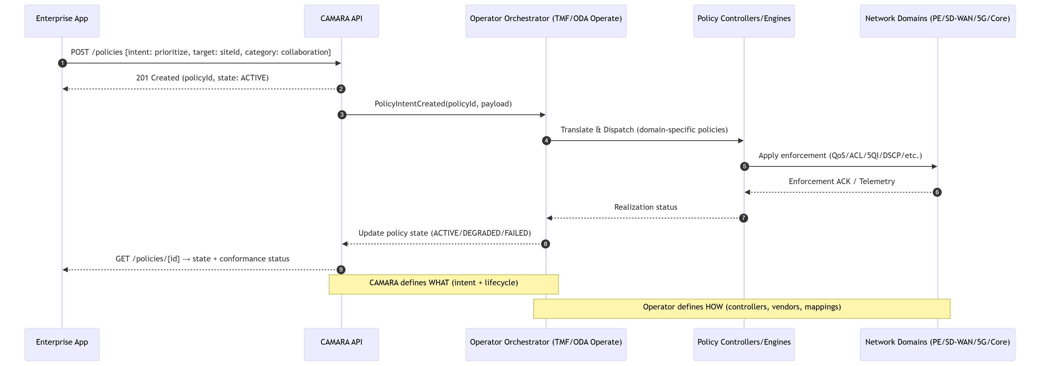
API Sequence Diagram

Slide 7
Connectivity Governance API
Overview
The Connectivity Governance API provides a unified, network-level policy enforcement capability that enables telecom operators to offer enterprise customers precise control over application access, bandwidth usage, compliance, and productivity—without requiring any device-level software, agents, or MDM configurations. By exposing a portable, intent-based interface, the API allows enterprises to define governance rules that are enforced directly at network gateways such as PE routers, SD‑WAN edges, and mobile core policy functions, making them tamper‑proof, unpassable, and effective across all employee devices, including unmanaged BYOD endpoints.
When invoked with specific governance intents—such as category-based restrictions, time-based rules, rate limits, or prioritization requirements
the operator translates these portable policies into network-level enforcement using SD‑WAN controllers, router ACLs, firewall rules, DNS filters, or mobile core PCF configurations. This enables enterprises to achieve consistent, cross-network enforcement across MPLS, SD‑WAN, broadband, mobile networks, and 5G slices through a single, standardized API.
Designed to support multi-site, hybrid-work, and multi-access enterprise environments, the Connectivity Governance API enables organizations to enforce productivity controls (e.g., restricting streaming during work hours), enhance security posture (e.g., blocking VPN/proxy or TOR usage), safeguard critical operations (e.g., prioritizing real-time collaboration traffic), and ensure compliance in sensitive sectors such as banking, healthcare, government, and manufacturing. The API is equally effective across fixed, mobile, and cloud-connected environments, offering a unified governance layer for modern distributed enterprises.
By leveraging this API, operators can deliver governance-as-a-service—bundled with MPLS, SD‑WAN, enterprise broadband, mobile corporate plans, or 5G slicing, creating a differentiated and revenue-generating value proposition. Enterprises benefit from simplified management, stronger security, and consistent enforcement without the overhead, privacy concerns, or bypass risks associated with endpoint agents.
Additionally, the API enables rapid, policy-driven control across site‑to‑site, site‑to‑cloud, and device‑to‑network scenarios, ensuring reliable and compliant access regardless of network type or device used.

Slide 8
API Functions
API name | API function | Method | Description
/capabilities | List supported capabilities | GET | Discovery for actions/limits
/capabilities/categories | List category taxonomy | GET | Discovery for content filtering
/connectivityScopes | List scopes | GET | Filter by type/labels
/connectivityScopes/{scopeId} | Get scope | GET
/policies | Create policy | POST | Idempotency key supported
/policies | List policies | GET | Filter by scopeId, state, category
/policies/{policyId} | Get policy | GET
/policies/{policyId} | Update policy | PATCH | Partial update
/policies/{policyId} | Delete policy | DELETE | Soft or hard delete (operator‑specific)

Slide 9
Sample payload (Create)
{
"scopeId": "site:Site-001",
"description": "Work-hours productivity controls",
"valid-From": "2026-03-01T08:00:00",
"valid-Until": "2026-06-30T18:00:00",
"priority": 50,
"rules": [
{
"action": "DENY",
"target": { "categories": ["streaming.video", "gaming"] },
"schedule": {
"timezone": "Europe/London",
"days": ["MON","TUE","WED","THU","FRI"],
"start": "09:00",
"end": "18:00"
}
},
{
"action": "PRIORITIZE",
"target": { "appIds": ["msteams", "zoom"] },
"qos": { "dscp": 46, "class": "EF" }
}
]
}

Slide 10
User story
item | Details
Summary | As an enterprise customer or application developer, I want to define and enforce network‑level governance policies (e.g., allow/deny rules, bandwidth limits, prioritization, time‑based restrictions) using my backend/application server, so that I can ensure secure, compliant, productive, and optimized connectivity for my organization across MPLS, SD‑WAN, broadband, and mobile networks—without installing or managing any device‑level software or agents.
Roles, Actors and Scope | Roles: Enterprise Customer, Network/IT Administrators, Application Developers / Integrators Actors: Enterprise IT teams, Application service providers, Enterprise customers using multi‑site or hybrid network environments Scope: Service assessment: Query operator-supported governance capabilities (categories, application catalogue, scope availability).Create, modify, delete, enable, disable, and retrieve network governance policies, Define and manage Connectivity Scope resources (enterprise, site, segment, subscription group, or slice).
Activities/Steps | Starts when: The enterprise application server makes a POST request to the Connectivity Governance API, providing the required connectivity scope (e.g., enterprise/site/segment), along with policy intents such as application categories, allowed/denied services, rate limits, time windows, or QoS requirements. This call creates a new Policy resource associated with the selected Connectivity Scope. Possible Input parameters: Target site / enterprise / segment / mobile subscription group Governance rules (deny streaming video, rate-limit social media, prioritize collaboration, etc.) Time windows (business hours, emergency windows, maintenance periods) Bandwidth prioritization or throttling thresholds. Ends when: The enterprise application server issues a DELETE request for the policy, or the operator automatically removes the policy because: The enterprise‑specified validity period expires, or A default operator-defined enforcement window or expiration limit is reached (e.g., emergency rule expiry, temporary enforcement rules). At this point, the associated governance rule is removed, and the network enforcement reverts to default or previously active baseline policies.

Slide 11
Connectivity Governance Deliverables Plan
Deliverable Required/Optional (R/O) Current status
API Specs | R | In Progress
API documentation | R | TBD
User stories | R | Available
Test cases | R | TBD
Implementation | O | TBD

